Slide 1


Responsible AI for Hate Speech Detection
A Comprehensive Pipeline
Advancing Information-Systems and Human-Computer Interaction Theory
August 4, 2025

Slide 2

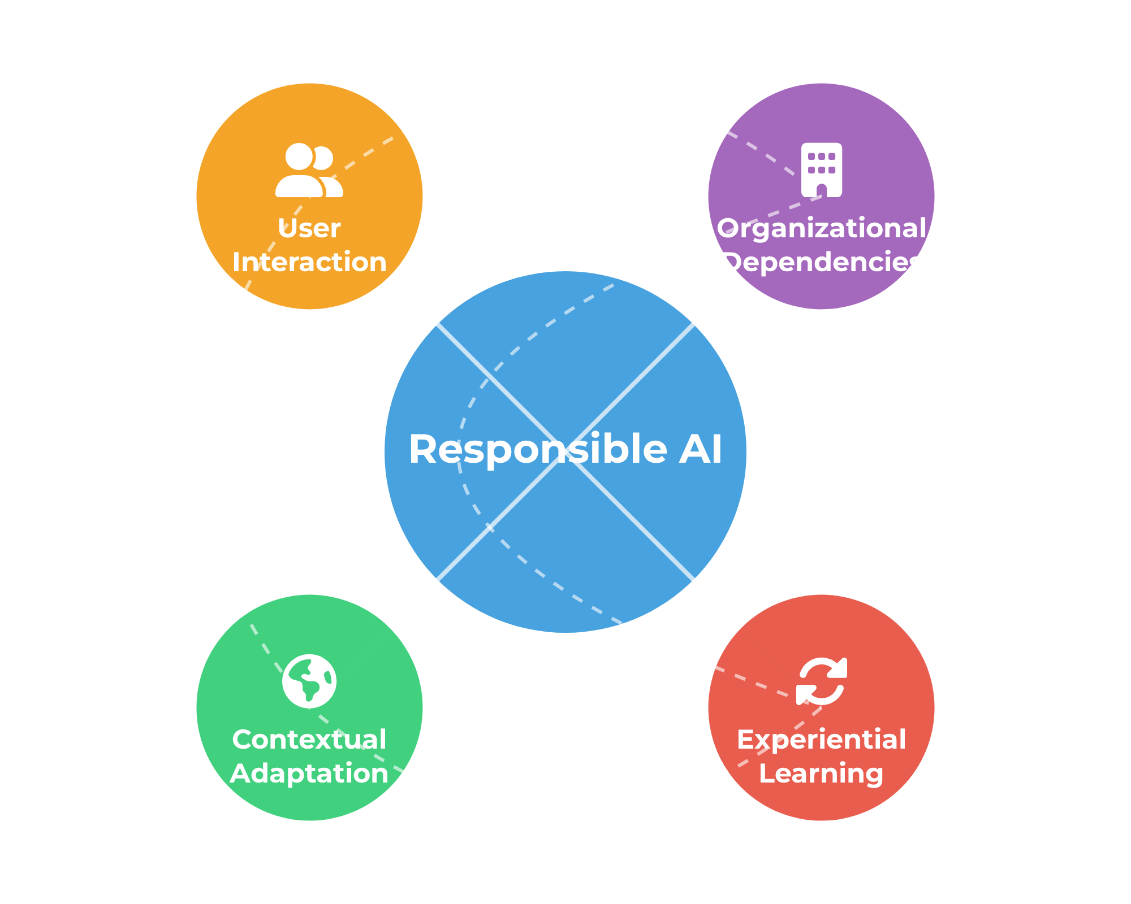




Four Interwoven Dimensions
Our approach integrates four key dimensions to create a comprehensive responsible-AI pipeline for hate speech detection
Experiential Learning
Continuous feedback loop where the system learns from moderator interactions and corrections
Contextual Adaptation
Dynamic adjustment based on temporal events, regional factors, and organizational policies
User Interaction
Transparent interface with multi-modal explanations that empowers moderators
Organizational Dependencies
Integration with platform-specific policies, guidelines, and governance structures

Slide 3

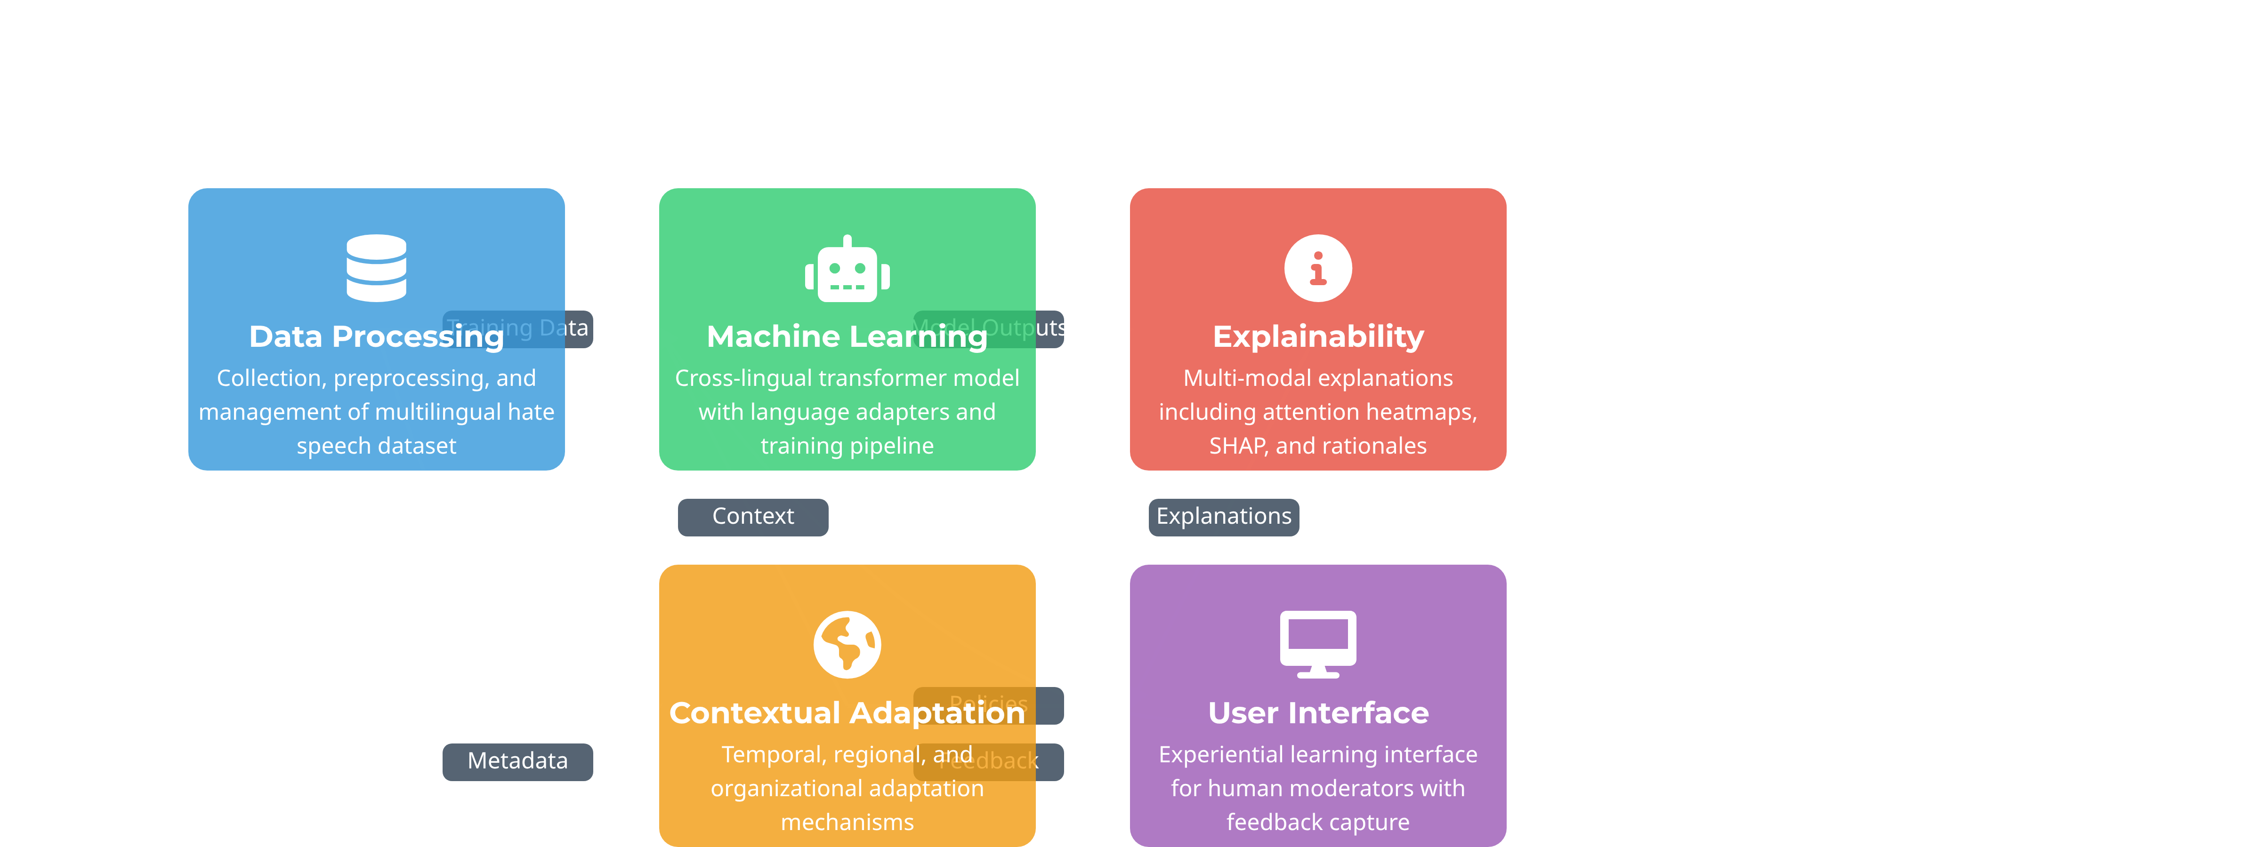
System Architecture
A modular design organized around five core subsystems that work together to enable responsible hate speech detection

